Slide 1
Client Meeting 4

Slide 2
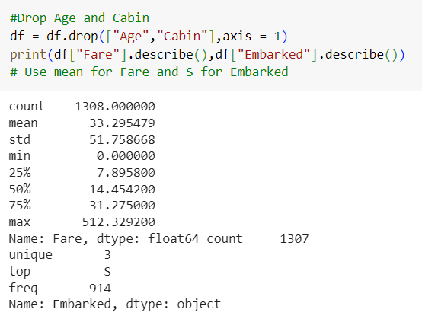
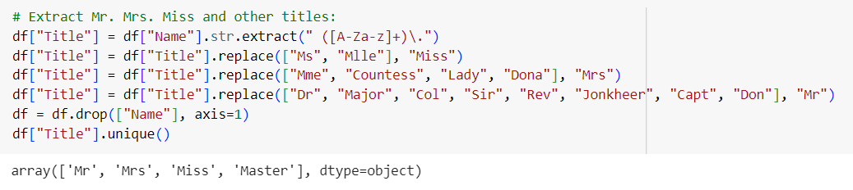
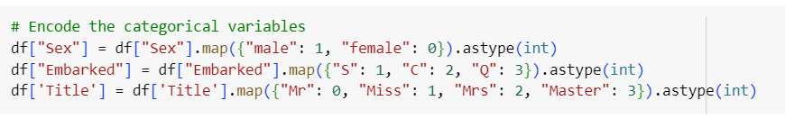
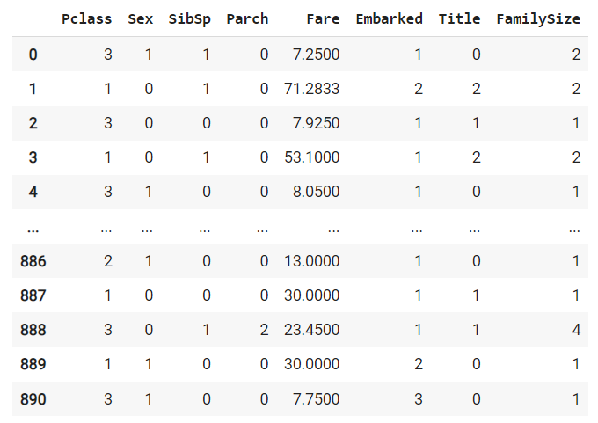

Age and Cabin had too many missing values so they were dropped
Fare and Embarked na values filled in
Categorical variable encoding:
Mr, Mrs, Miss, and Master
Male and Female
Embarked
New feature: FamilySize = SibSp + Parch + 1(oneself)

Slide 3
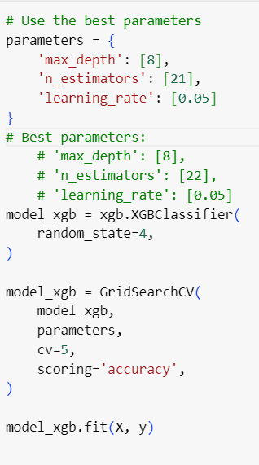
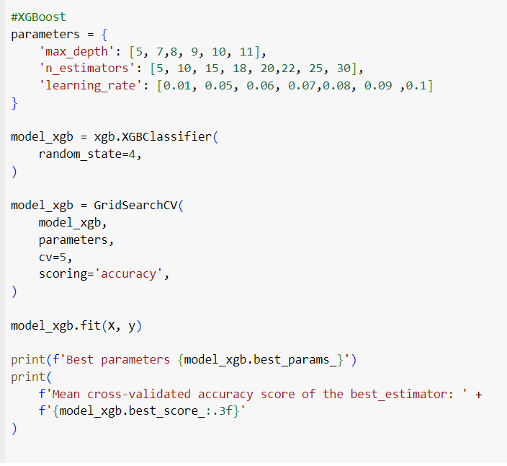
Implementing XGBoost
Determined the best parameters based on gridsearch results
Implemented XGBoost using the results
Evaluated the cross-validation to ensure accuracy across folds.

Slide 4
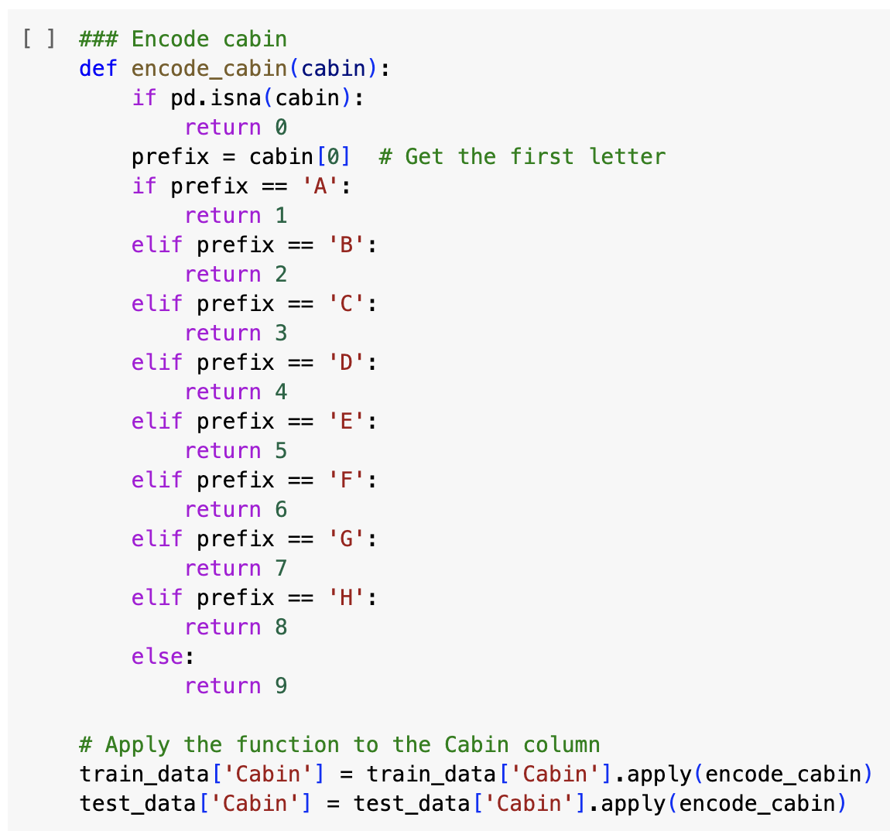
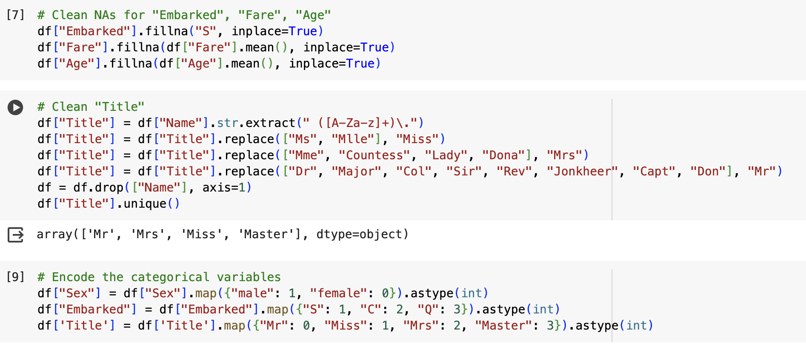
Some takeaways
Variable selections:
Age and Cabin had too many missing values so they were dropped
Encoding Cabin, filling in Age NA values with mean
Fare and Embarked na values filled in
Title feature: Mr, Mrs, Miss, and Master
New feature: FamilySize = SibSp + Parch + 1(oneself)
More exploratory data analysis
Carefully dealing with NA values:
If it’s too much, it would be better to delete
When trying to fill in NA values with mean or mode, remember to use the entire dataset
Double-checking after data cleaning

Slide 5
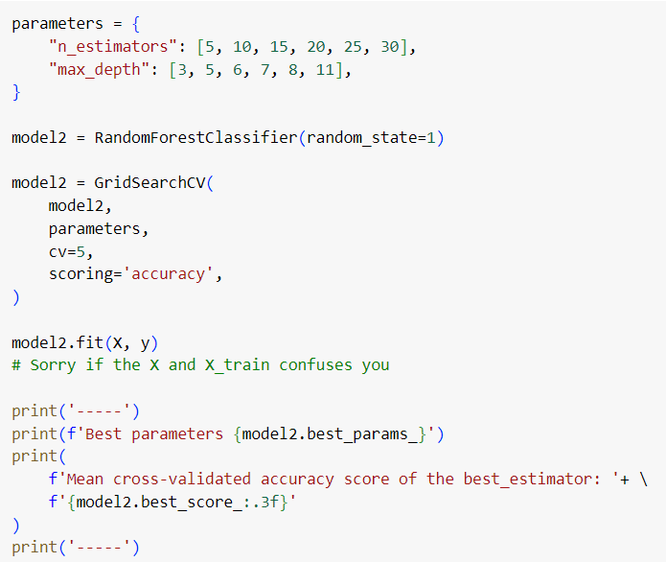
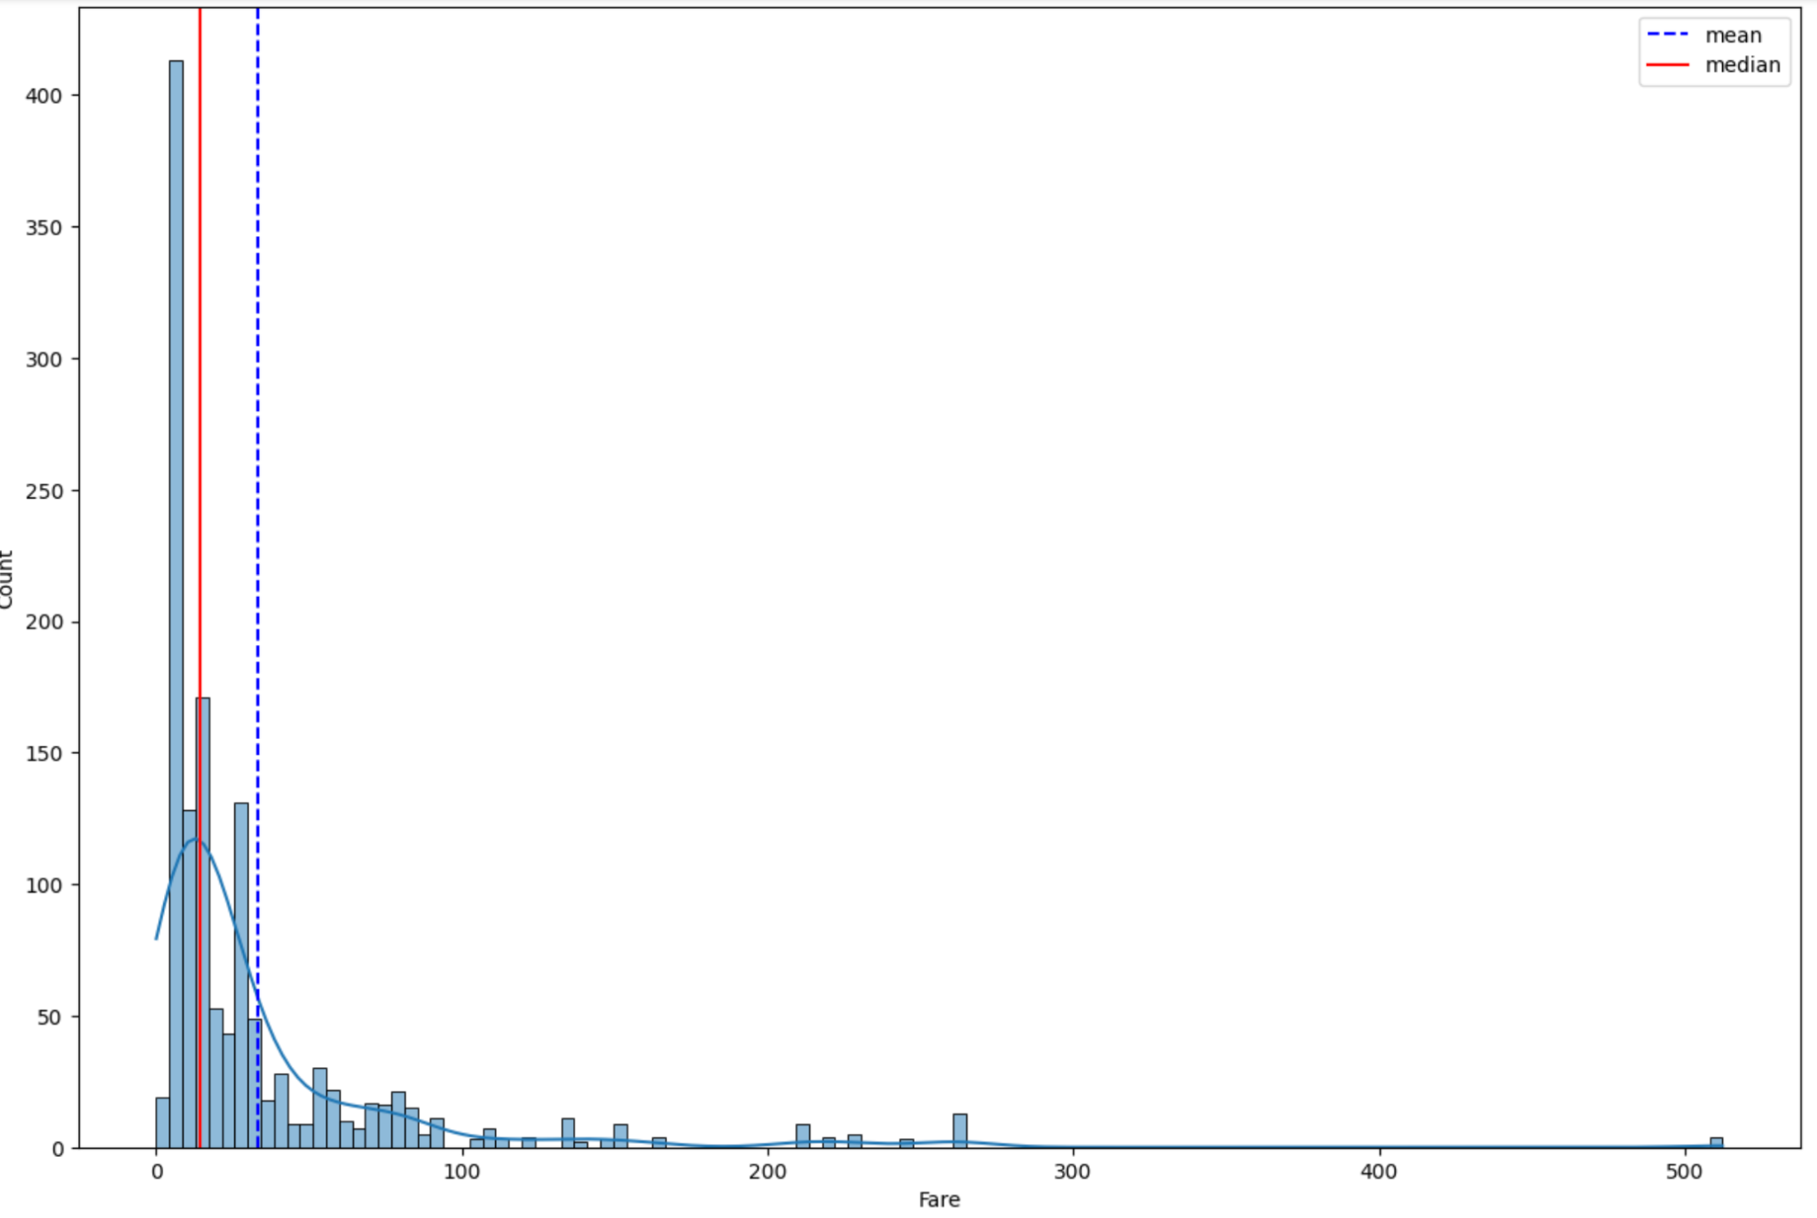
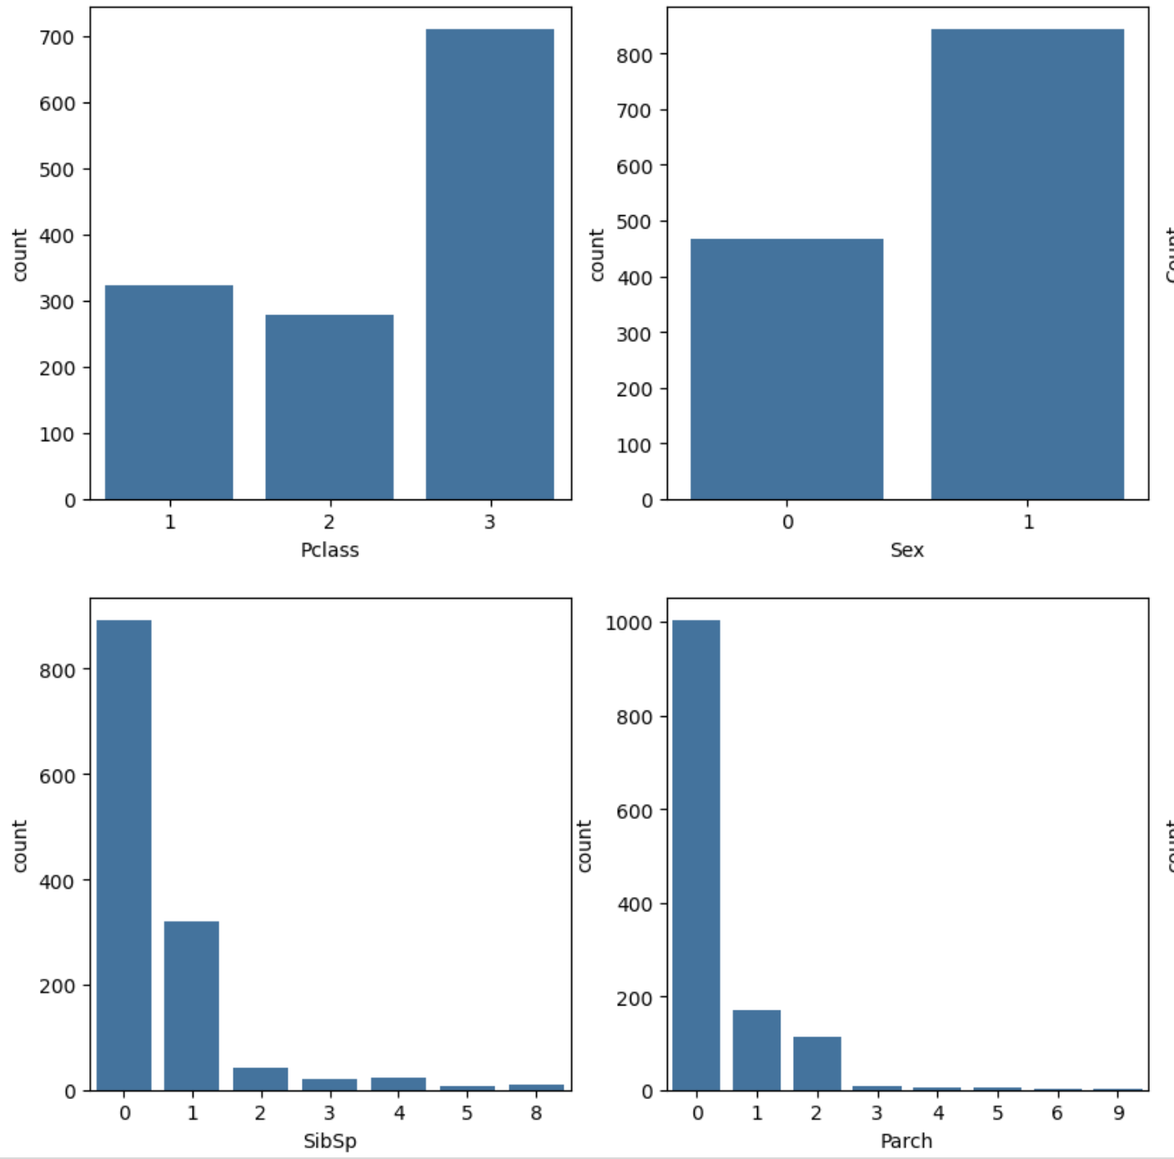
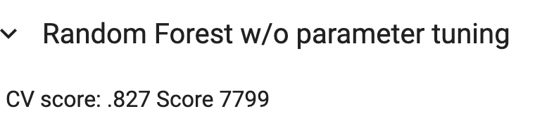
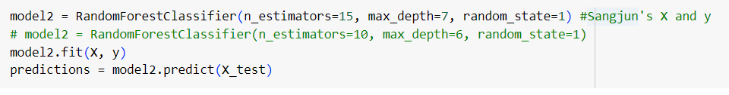
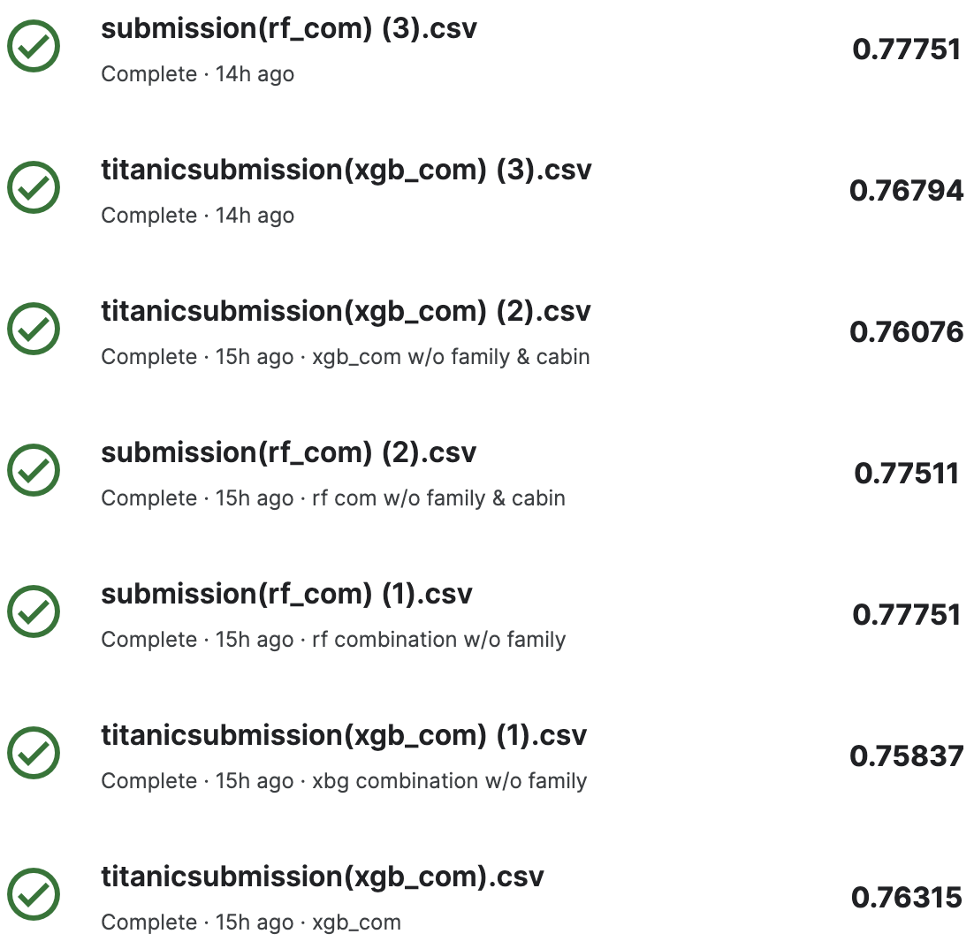
Some takeaways
Among different training models:
Generally XGBoost and Random Forest performs better than logistic regression
Better capability to handle imbalanced data
Compared to random forest, XGBoost is more sensitive with different variable selection.
Random forest: more robust to noisy data and small features

Slide 6
